Slide 1
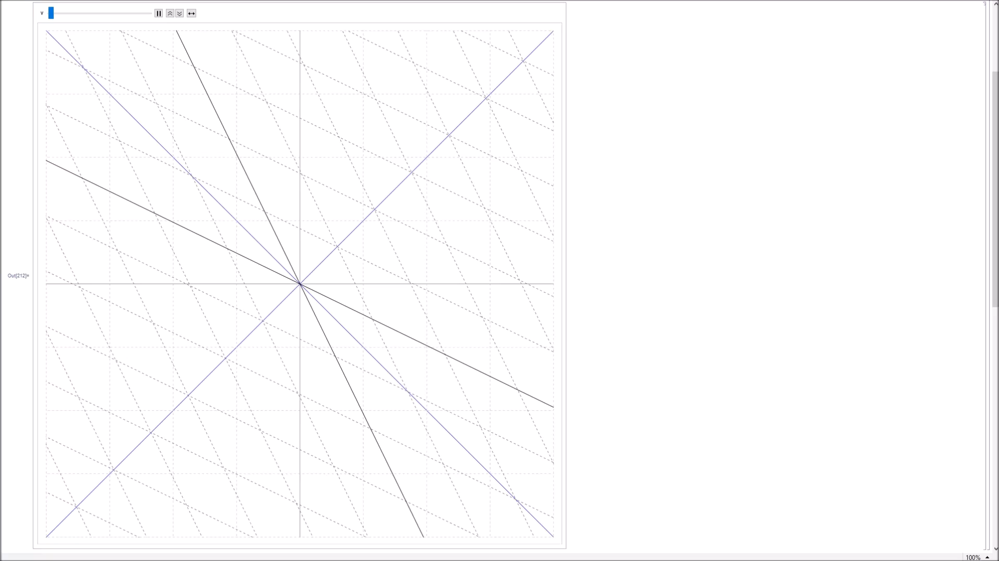
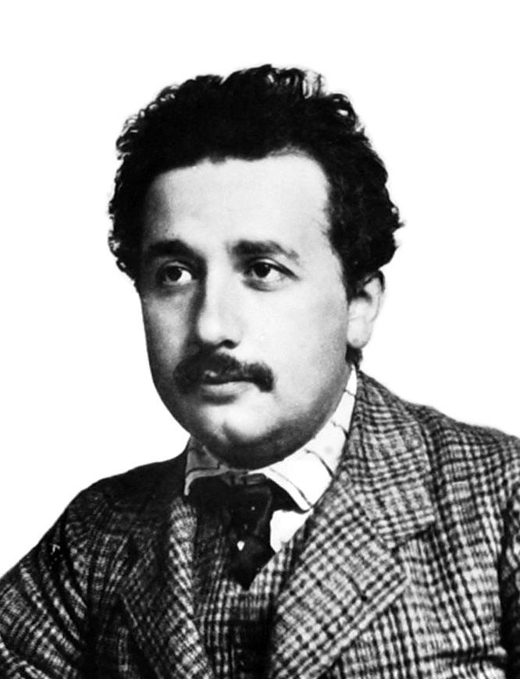
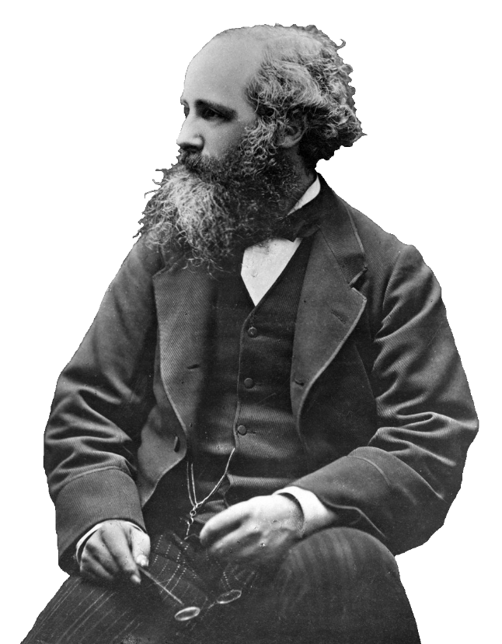
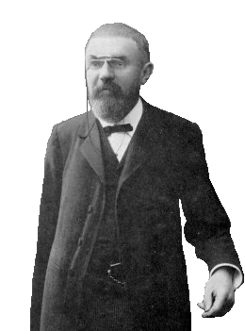
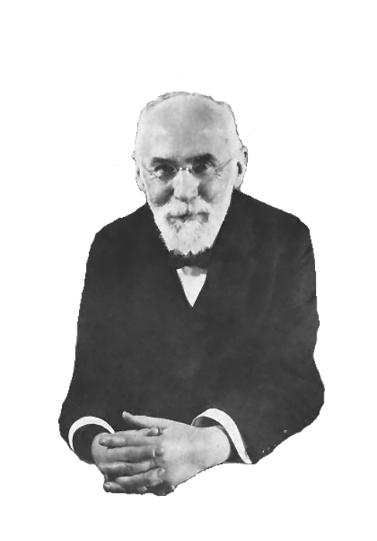
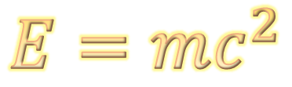
The Foundations of
Special Relativity
$$E=mc^{2}$$
Tom Dodd

Slide 2
Topics to Cover…
Postulates of Relativity
Lorentz Transformations
1905-
1907
Basic Consequences
Relativistic Doppler Effect
Energy Mass Equivalence
“Modern” Relativity
1908-

Slide 3
Postulates of Relativity
1. Principle of Relativity:
The laws of physics are the same in all inertial reference frames.

Slide 4
Postulates of Relativity
1. Principle of Relativity:
The laws of physics are the same in all inertial reference frames.
Newton’s Laws of Motion
Newton’s Law of Gravity
Laws of Electricity & Magnetism
Laws of Thermodynamics

Slide 5


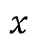
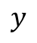
Postulates of Relativity
1. Principle of Relativity:
The laws of physics are the same in all inertial reference frames.
$$y$$
Coordinate system
$$x$$
CARTESIAN
POLAR

Slide 6
Postulates of Relativity
1. Principle of Relativity:
The laws of physics are the same in all inertial reference frames.
Non-accelerating
No fictitious forces
Energy conservation

